Slide 1
Preparing for the Unthinkable: Understanding Communities in Disaster Management
Designing effective risk communication strategies and awareness campaigns
Irfan AHMAD rana
Assistant Professor
DEPT. of Urban and regional planning, school of civil and environmental engineering (SCEE), NUST

Slide 2
Understanding Disaster Risk

Slide 3
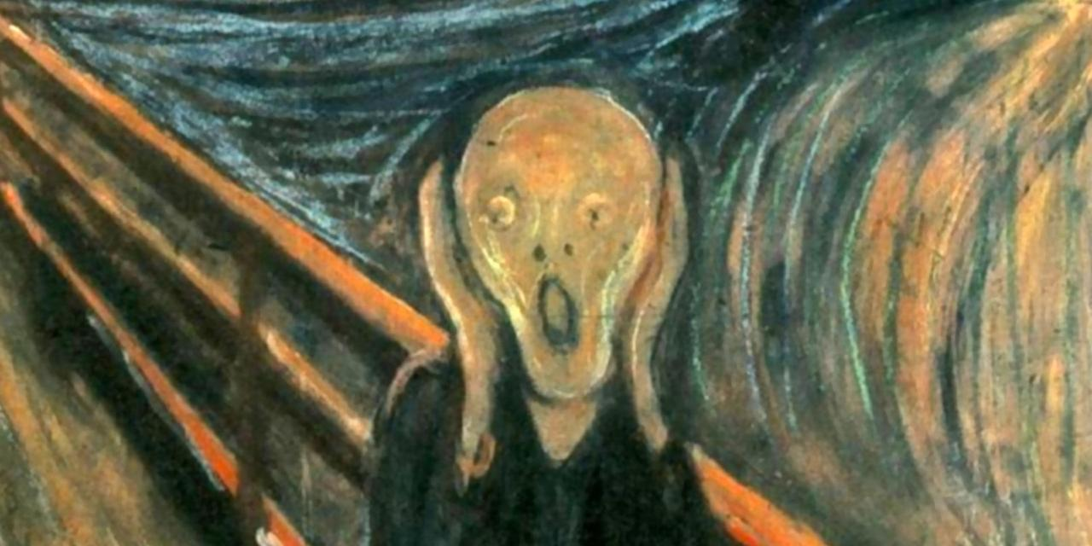
DISASTER
What does it mean?

Slide 4
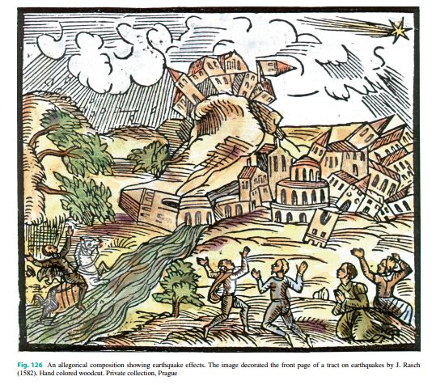
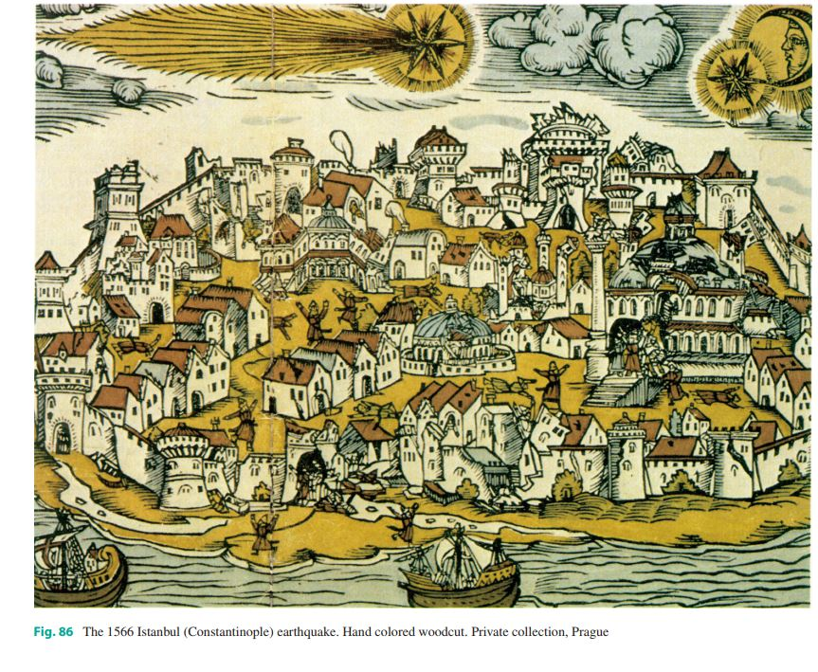

Slide 5
Genesis of Disaster
Originated from Greek dus = bad, and aster = star
Evolved in Italian as disastro,
To become French désastre
& then disaster .

Slide 6
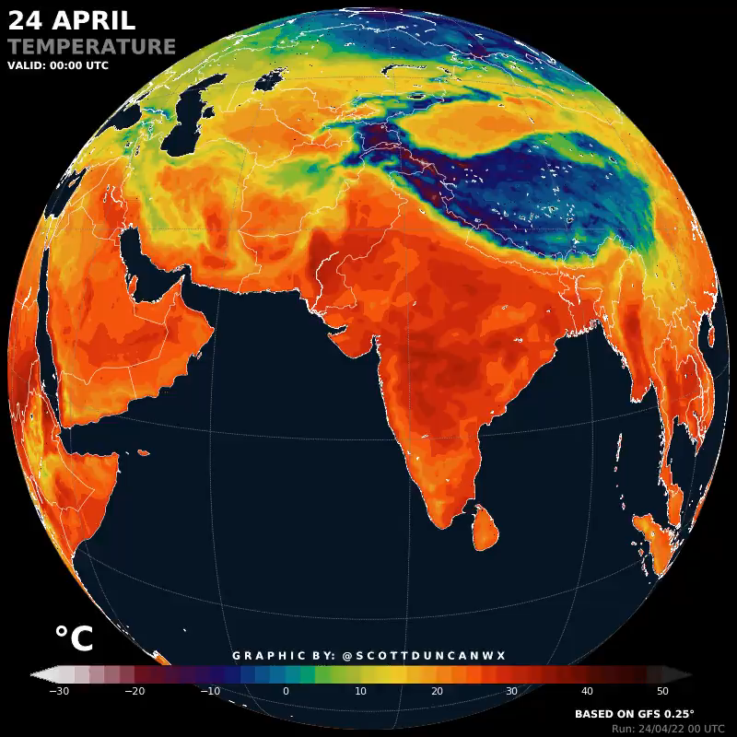
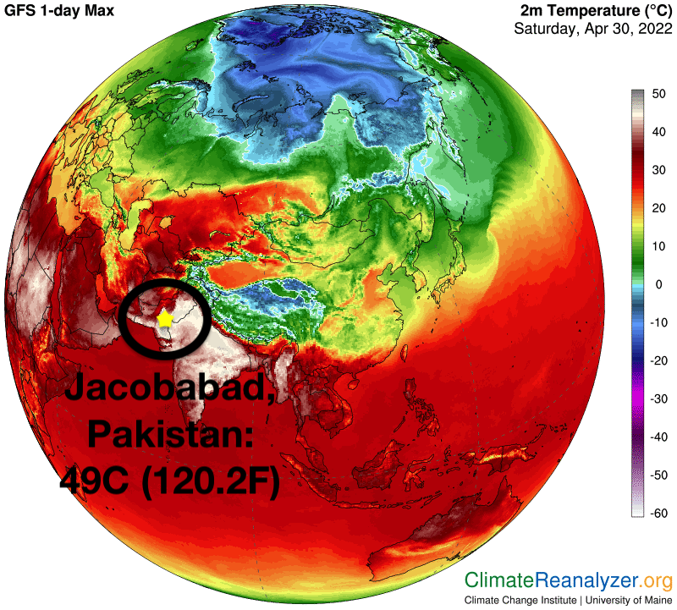
Climate Change and Pakistan
6

Slide 7
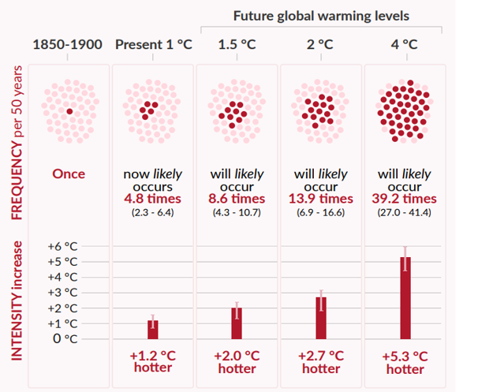
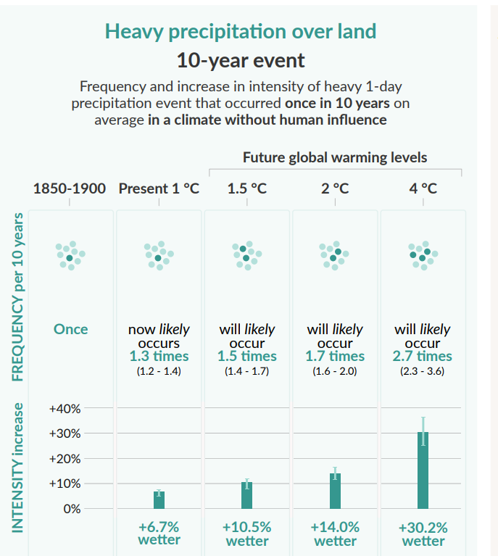
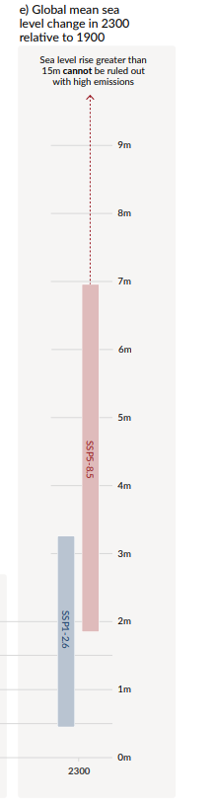
Climate Change and Pakistan
30 times more likely to occur in the future
Extreme rainfall will increase by 7% with 1 degree change
Minimum of 7-meter rise of Sea Level Rise

Slide 8
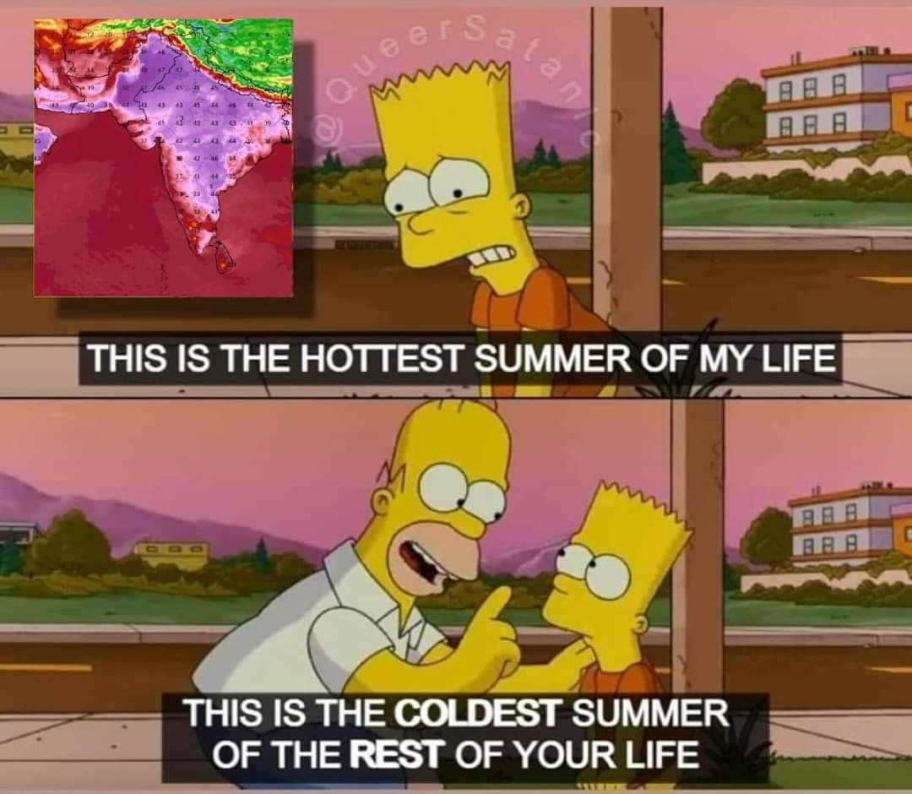

Slide 9
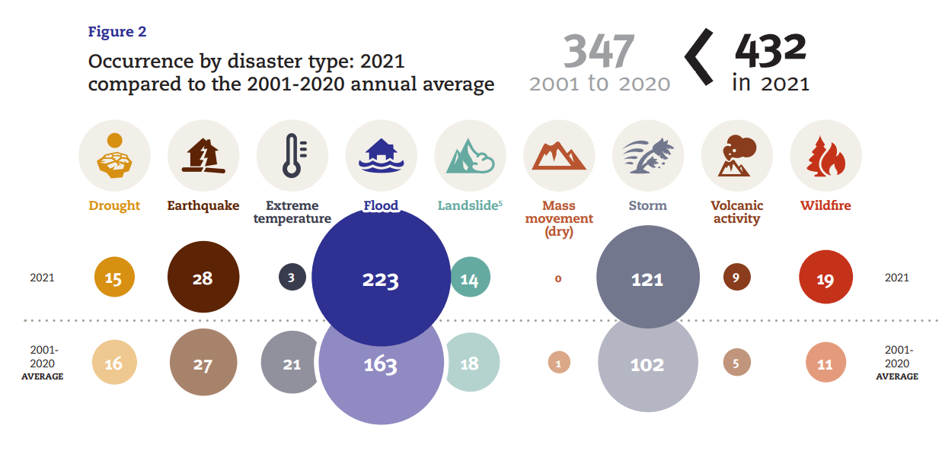

Slide 10
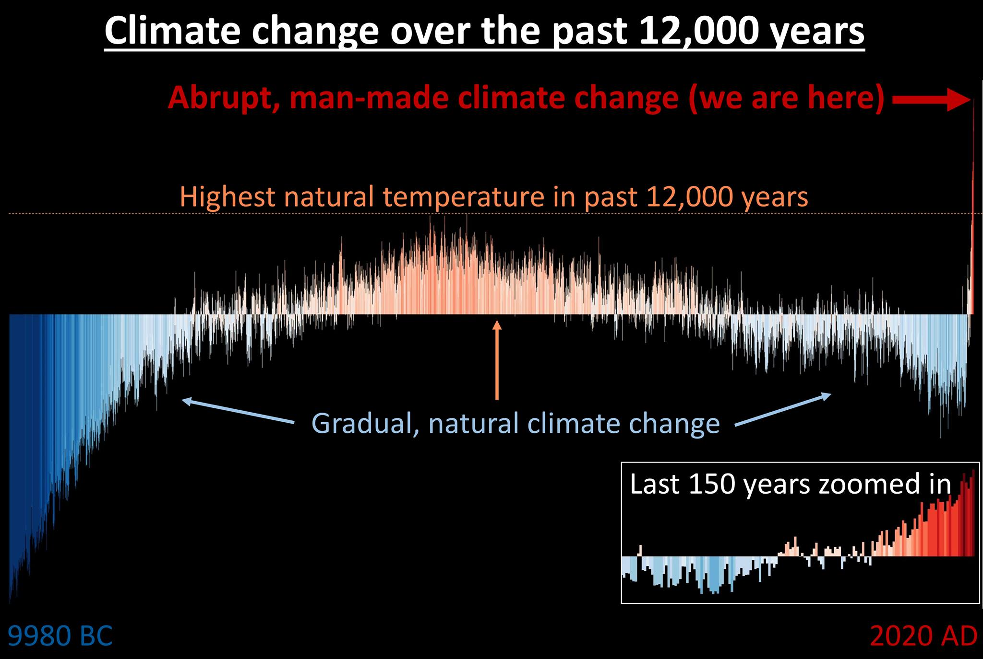

Slide 11

100 mm
1961-1990
Jan
Feb
Mar
Apr
May
Jun
Jul
Aug
Sep
Oct
Nov
Dec
100 mm
Climate: 1991-2010
Same
Increase
Decrease
1991-2010
Jan
Feb
Mar
Apr
May
Jun
Jul
Aug
Sep
Oct
Nov
Dec
100 mm
Climate: 2011-2020
2010-2020
Jan
Feb
Mar
Apr
May
Jun
Jul
Aug
Sep
Oct
Nov
Dec

Slide 12
Understanding Disaster: Concepts and Constructs

Slide 13
Hazard
A hazard is a situation which poses a level of threat to life, health, property or environment.
A potential of natural geophysical or hydro-meteorological events that may cause damages to an area over a specific period of time (Birkmann, 2006).
A natural hazard is a natural phenomenon that can potentially trigger a disaster

Slide 14
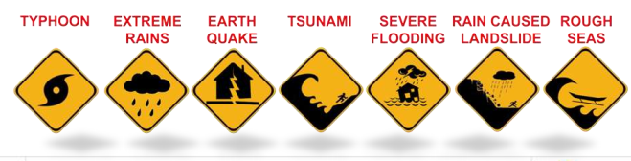
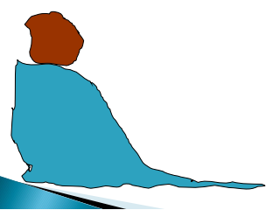

Slide 15
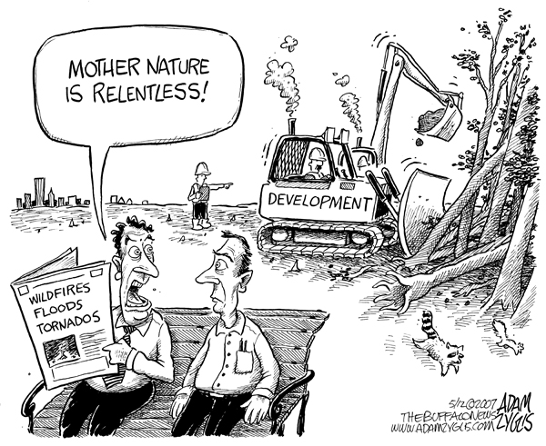

Slide 16
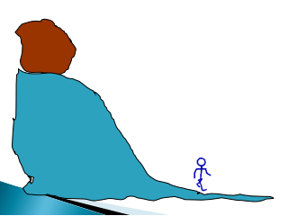

Slide 17


Vulnerability
The characteristics and circumstances of a community, system or asset that make it susceptible to the damaging effects of a hazard.
Notes:
There are many aspects of vulnerability, arising from various physical, social, economic, and environmental factors. Examples may include poor design and construction of buildings, inadequate protection of assets, lack of public information and awareness, limited official recognition of risks and preparedness measures, and disregard for wise environmental management. Vulnerability varies significantly within a community and over time. This definition identifies vulnerability as a characteristic of the element of interest (community, system or asset) which is independent of its exposure. However, in common use the word is often used more broadly to include the element’s exposure.

Slide 18
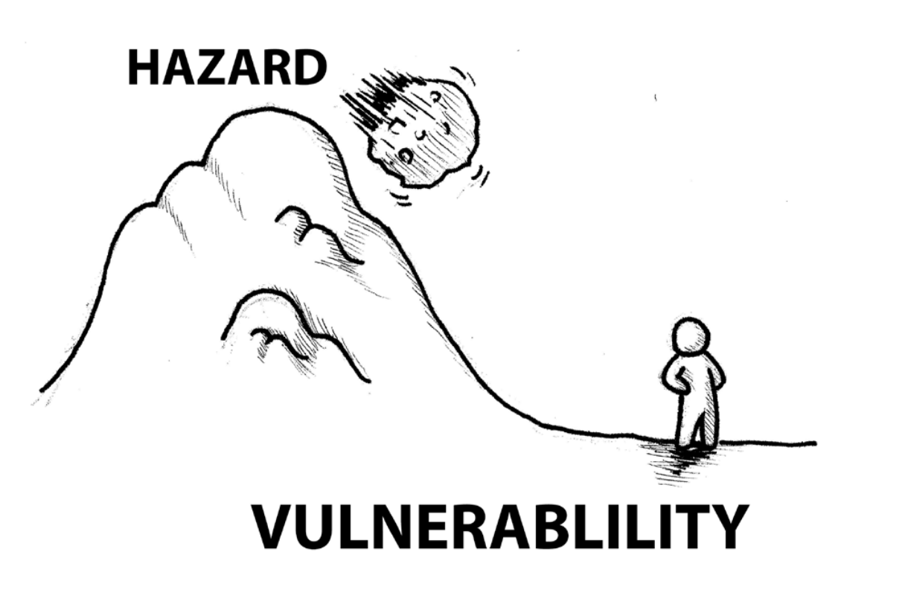

Slide 19
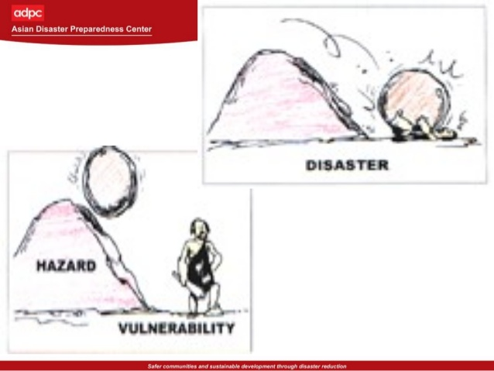

Slide 20
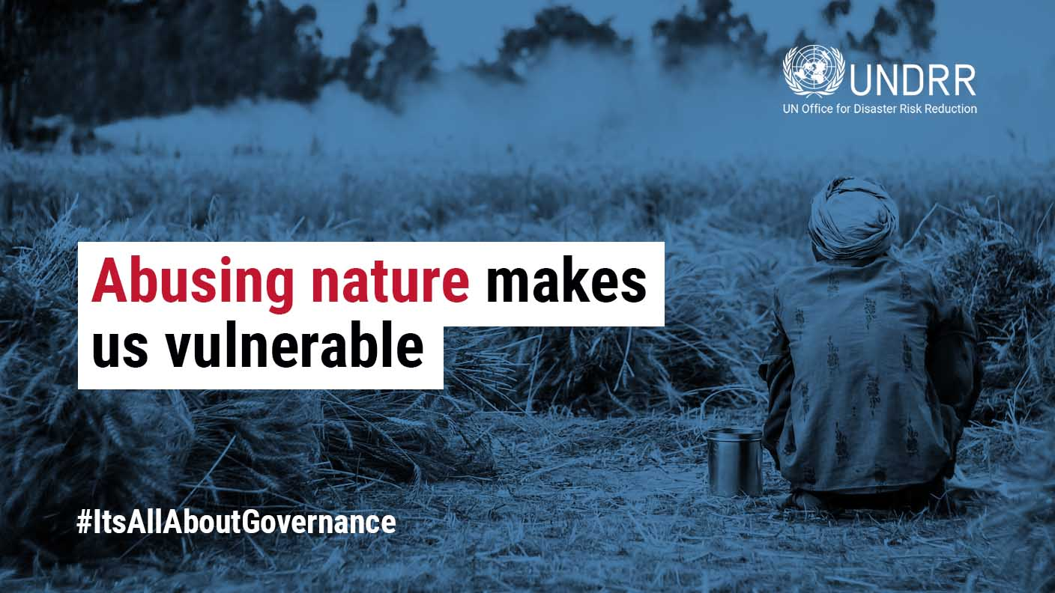

Slide 21
Concept of Risk
Risk(R)
HAZARD(H)
VULNERABILITY(V)
DISASTER
Modified from C.Wamsler, Lund Univerisity 2012

Slide 22
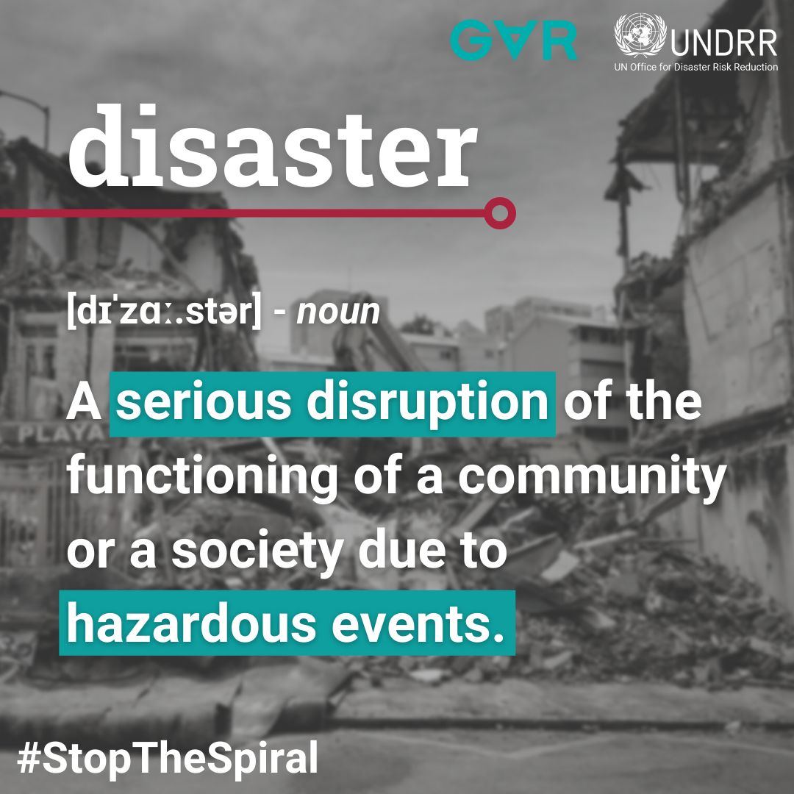
What is disaster?

Slide 23
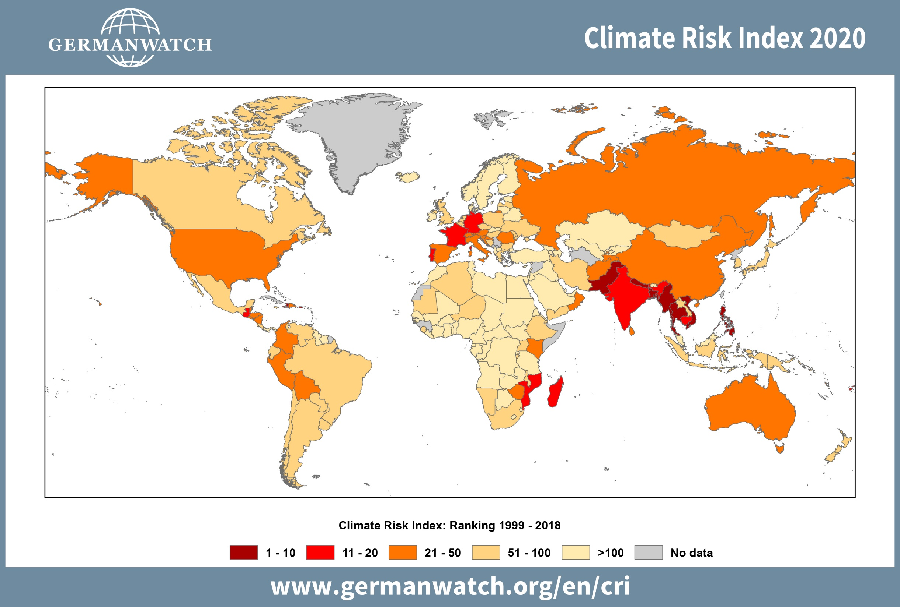

Slide 24
The Disaster Risk Equation
R = H X V

Slide 25
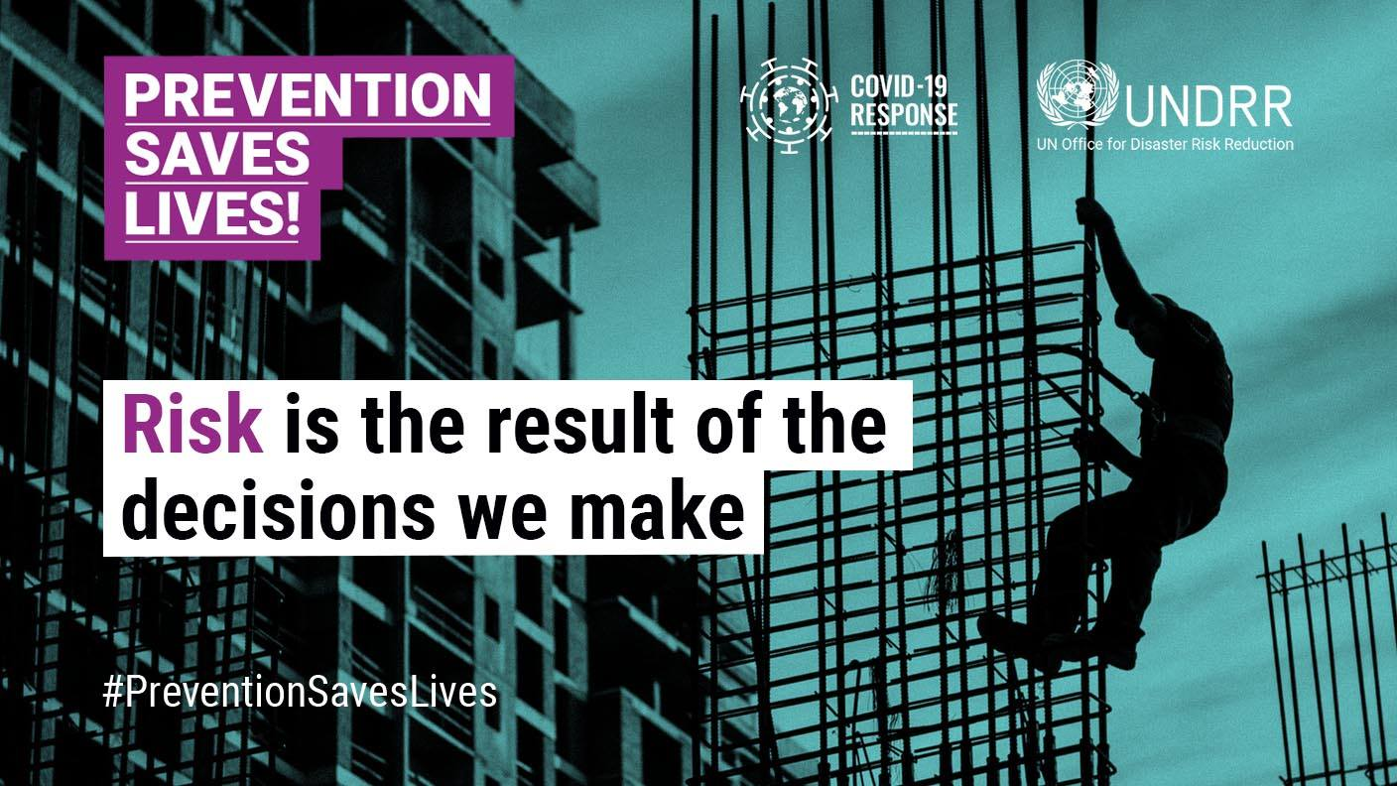

Slide 26
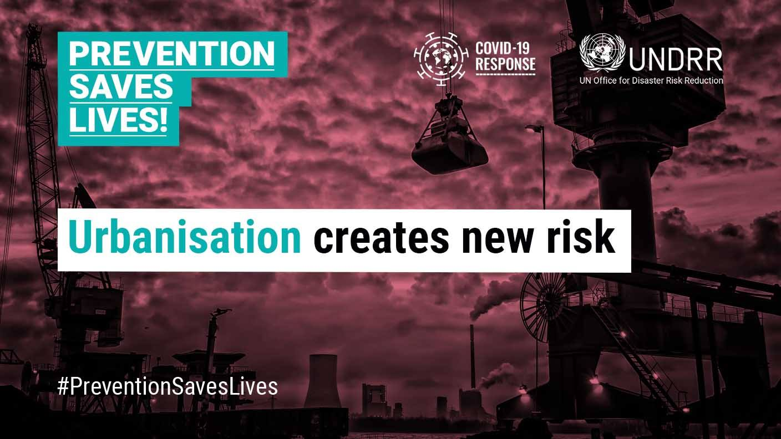

Slide 27
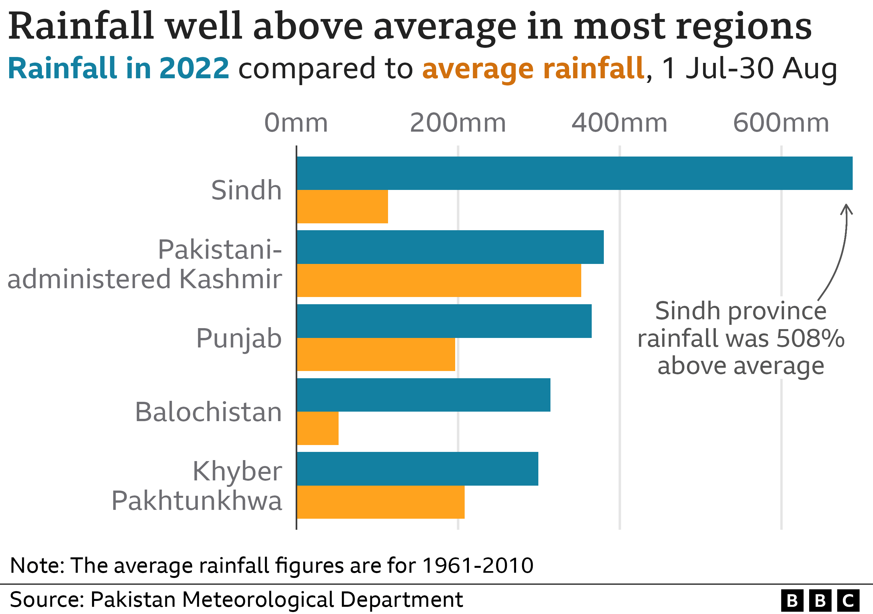
100 mm
1961-1990
Jan
Feb
Mar
Apr
May
Jun
Jul
Aug
Sep
Oct
Nov
Dec
100 mm
Climate: 1991-2010
Same
Increase
Decrease
1991-2010
Jan
Feb
Mar
Apr
May
Jun
Jul
Aug
Sep
Oct
Nov
Dec
100 mm
Climate: 2011-2020
Jan
Feb
Mar
Apr
May
Jun
Jul
Aug
Sep
Oct
Nov
Dec
2010-2020

Slide 28
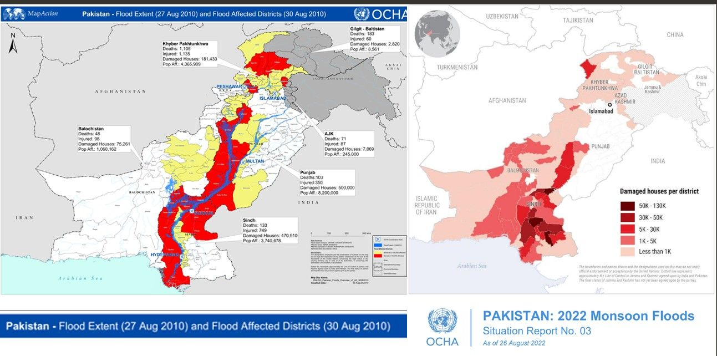

Slide 29
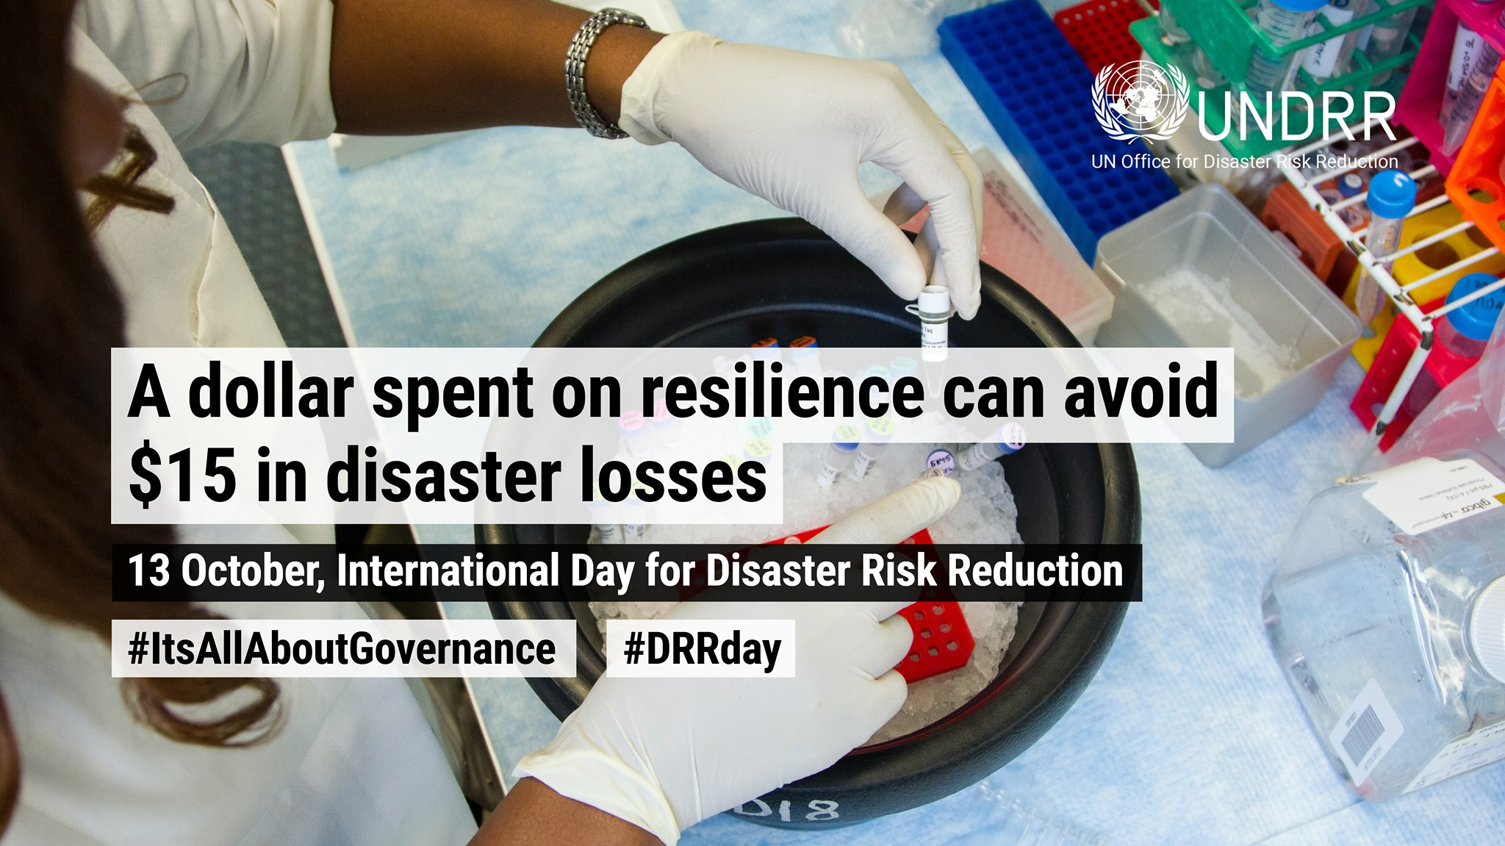

Slide 30
Understanding Communities

Slide 31

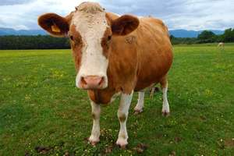

Slide 32
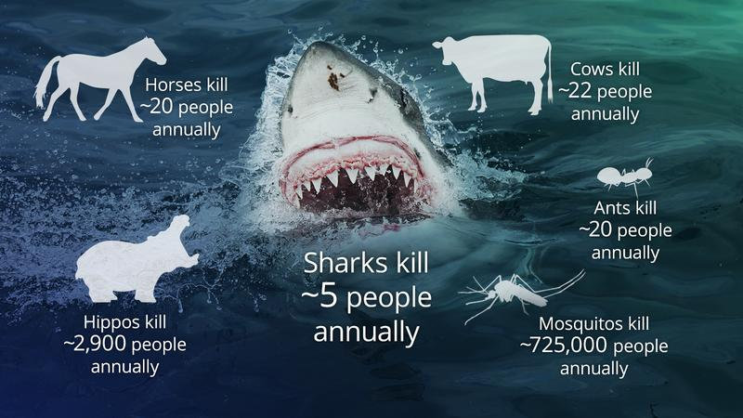

Slide 33
Perception
is
reality
Notes:
Sandman has stated that for every individual their perception is their REALITY.
Isn’t it the same for us? What we perceive to be a risk is our reality.
The Three Mile Island release in 1979 is a good example.
The release of 15 curies of radiation that took place is similar to what anyone of us in the US receives in a week’s time from background radiation. However, the lack of appropriate communication to the population and mismanagement of the event might have triggered the high levels of stress among the residents of the area.
They perceived it to be a risk. For them it was a risk.

Slide 34
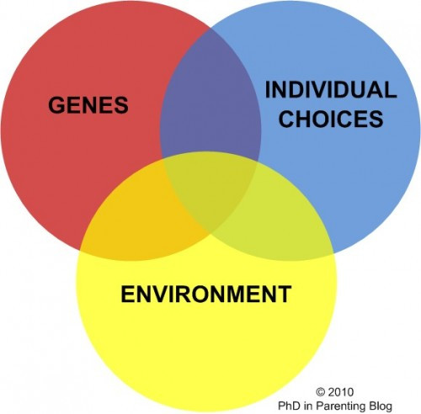
The concept of risk perception?
How people make sense of their world
Risk perception has become standard in scientific community to measure public judgements, reactions, behaviour and acceptance regarding an event or strategy.

Slide 35
The Myths
It Can’t Happen to Us.
The Nature’s forces are so Deadly the Victims will Die anyway.
There is Nothing We Can Do.
It can’t happen again.

Slide 36
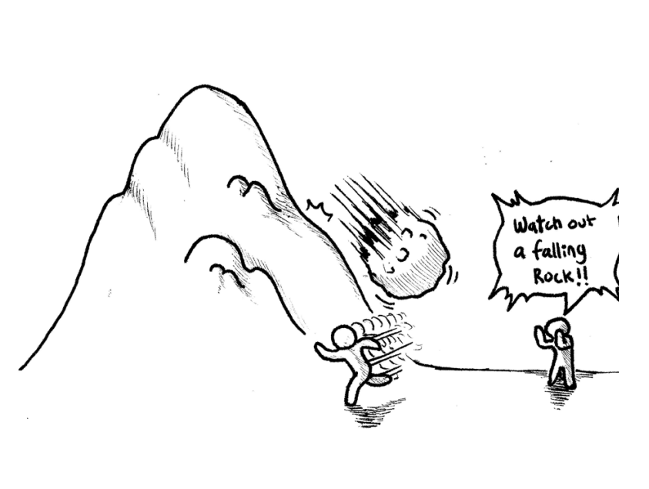
Risk perception and communication

Slide 37
Why Study Disaster Risk Perception?
Risk perception has much to do with how people behave in time of crisis.
Different people look at the same hazard differently
Generally, a positive influence between preparedness and risk perception

Slide 38
Communicating Risk: Shaping public awareness and knowledge

Slide 39

Risk Communication
Risk Communication is popularly known as public awareness or public education.
It is basically informing (bridging) science to public, in a simple manner.
"The interactive process of exchanging information and opinion among individuals, groups, and institutions involving multiple messages about the nature of risk...“*
-- The US National Research Council
*(Note the emphasis on multi-directional communication!)

Slide 40
Who The Public Perceives As Credible
MOST CREDIBLE
Local citizens perceived as neutral, respected, informed about the issue
Health/safety professionals (nurses, physicians, firefighters)
Professors/educators (especially from respected local institutions)
Clergy/ Religious Organizations
Non-profit organizations
Media
Environmental/advocacy groups
Federal government
State/local government
Industry
“For profit” consultants
LEAST CREDIBLE

Slide 41
Instructor's Profile
Contact: iarana@nit.nust.edu.pk (For appointment)
Room 120 NIT Building
Google Scholar Profile:
https://scholar.google.com.pk/citations?user=0PzxjtEAAAAJ&hl=en
Online lectures: https://www.youtube.com/c/IRFANRANACRP/playlists

Slide 42


Slide 43
Suggested Readings
Kelman, I. (2019). Axioms and Actions for Preventing Disasters. Progress in Disaster Science.
Rana, I. A., Jamshed, A., Younas, Z. I., & Bhatti, S. S. (2020). Characterizing flood risk perception in urban communities of Pakistan. International journal of disaster risk reduction, 46, 101624.
Rana, I. A., Bhatti, S. S., Aslam, A. B., Jamshed, A., Ahmad, J., & Shah, A. A. (2021). COVID-19 risk perception and coping mechanisms: Does gender make a difference?. International Journal of Disaster Risk Reduction, 55, 102096.
Rana, I. A., & Routray, J. K. (2016). Actual vis-à-vis perceived risk of flood prone urban communities in Pakistan. International Journal of Disaster Risk Reduction, 19, 366-378.

